Slide 1
Navigating Change and "Normalcy" in Online Learning
Students' Perspectives on Academic Integrity, Alternative Assessment, and Stress Management
ELLE TING AND ANDY SELLWOOD
EDUCATIONAL TECHNOLOGY USERS’ GROUP (ETUG)
2023 JUNE 1

Slide 2
SPECIAL THANKS…
Shaun Wong
Senior Research Analyst,
VCC Institutional Research
Tanny Marks
VCC Arbiter of Student Services
Student participants
Nations and Peoples on whose ancestral lands this work was conducted

Slide 3
BACKGROUND
“Sequel” to earlier project that focused on instructors’ perceptions regarding academic integrity and alternative assessment post-COVID
Uses the Fraud Triangle (Cressey, 1950) to examine predictors of academic misconduct
Initial study results supported the notion that changing assessments to manage student stress would be effective academic integrity protection
Second study was designed to explore students’ perceptions and experiences
Uses the Fraud Triangle (Cressey, 1950) to examine predictors of academic misconduct
Initial study results supported the notion that changing assessments to manage student stress would be effective academic integrity protection
Second study was designed to explore students’ perceptions and experiences

Slide 4
PROJECT TIMELINE
Dec 2020
Instructor survey
(146 respondents)
Feb 2021
Instructor focus groups
(12/40 respondents)
Jul 2022
Alternative Assessment Toolkit released
Jan-Feb 2023
Student survey (181/525 respondents)
Mar 2023
Student focus groups
(3/12 respondents)

Slide 5
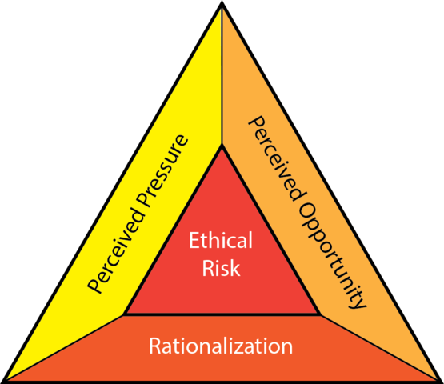
FrAud
Triangle
Based on the work of criminologist Donald Cressey (1950)
“If I fail this course, I’ll fail the whole program!”
“I google everything on my phone—why not this as well?”
Describes three risk factors for fraud
Applied to academic misconduct (Varble, 2014; Feinman, 2018)
Increasing the pressure on any one side of the triangle increases the risk of violating academic integrity
“But everyone else does it!”
Notes:
ELLE
note that putting more pressure on any one side is going to increase the likelihood of academic misconduct
-i.e., delivery model might not be the problem—increased stress changes students and makes them more likely to commit fraud

Slide 6
ACADEMIC INTEGRITY PROTECTION: FINDING THE SWEET SPOT
 | USE | EFFECTIVENESS | STUDENT CONCERN
TIME LIMIT | 85% | 68% | 65%
ZOOM INVIGILATION | 62% | 45% | 25%
RANDOMIZING ORDER/SET | 62% | 44% | 9%
RANDOMIZING VARIABLES/VALUES | 17% | 16% | 2%
NO BACK-FORTH | 17% | 17% | 18%
SAFE EXAM BROWSER | 10% | 7% | 3%
ACADEMIC INTEGRITY REMINDER | 72% | 45% | 8%
Notes:
ELLE

Slide 7
Learners’
POV

Slide 8
ASSESSMENT IS STILL quite “TRADITIONAL”
Despite delivery modes shifting away from fully in-person, traditional classrooms, assessments are similar to how they were before COVID.
​Students are split between those wanting to stick with traditional assessment and those interested in alternative assessments; many students want a mix of the two.
“I prefer the traditional assessments better because it’s what we’ve been taught all our school lives.”
“I believe [alternative assessments] are much more demonstrative of student learning than a timed multiple choice test.”

Slide 9
STUDENTS’ STRESS VARIES WIDELY
40% of students surveyed reported feeling more stressed in 2023 than they remember being in 2020.
However, 33% reported no change, and 27% said that they were less stressed at school than they were three years ago.
Self-pressure, peer pressure, and school-work balance were commonly identified as stressors.
“At the tail-end of the pandemic during Zoom there was less motivation [and] I’ve lost a bunch of time…feeling burnt out now and need a break.”
“I am working as I go to school so there is a different type of stress. Managing both finances and school stress is a different kind of stress…employment and school are in danger.”

Slide 10
ACADEMIC FRAUD IS NOT THE NORM
Students generally view academic fraud as an uncommon occurrence.
The perceived overall frequency of academic misconduct has not changed in the last three years (51% in both 2020 and 2023).
Like instructors, students believe that cheating is more likely to occur in take-home assignments.
“Making tests more practical demonstration of skills/knowledge instead of simple regurgitation is best. It is very obvious when someone cheats or when they are not confident in the material.”
“For online exams, the invigilators are watching, and we need to use two separate devices: one to monitor and one to do the exam on. It creates interruptions when the invigilator needs to tell us that we are no longer in the frame. If the instructor does not trust us, I would prefer to do the exam in-person and in silence. It is awkward having them watch us in this way.”

Slide 11
What motivates students
to take shortcuts?
MOTIVATES
Too much focus on grade as opposed to learning the material
Students who want to learn the material do not take short cuts
Depends on what the student’s ultimate goal is
Lack of preparation/time management
Pressure
Institutional focus on GPAs
Peer pressure – don’t want to be singled out or feel left behind
Assessment design

Slide 12
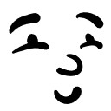
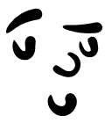
Please connect with us…
ANDY SELLWOOD
asellwood@vcc.ca
ELLE TING
eting@bccat.ca
Thank you!

