Slide 1
ETUG 2023
Afsaneh Sharif, Natasha Boskic, and AC Deger
University of British Columbia
Campus Wide Collaboration for Accessible and Inclusive Design
Notes:
Image from pexel Photo by Pixabay: https://www.pexels.com/photo/three-people-sitting-beside-table-416405/

Slide 2
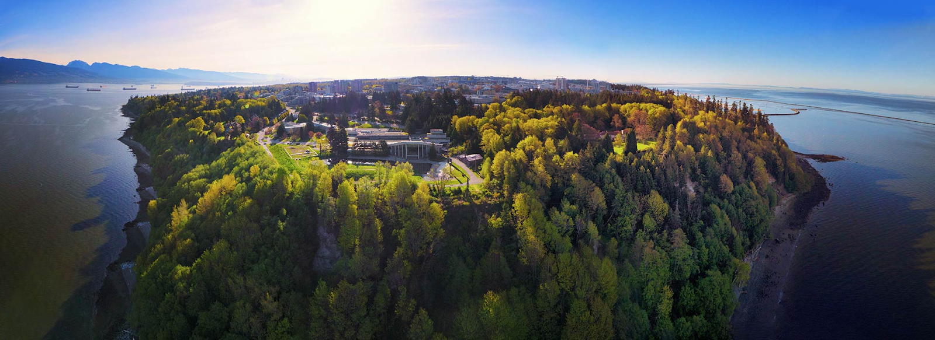
Land Acknowledgment
University of British Columbia (UBC) Point Grey Campus (Vancouver, Canada)​ located on the traditional, ancestral, and unceded territory of the xwməθkwəy̓əm
(Musqueam) People.​
​
Notes:
University of British Columbia (UBC) Point Grey Campus (Vancouver, Canada)​ located on the traditional, ancestral, and unceded territory of the xwməθkwəy̓əm
(Musqueam) People.​
​ UBC Okanagan Campus (Kelowna) ​ located on the traditional, ancestral and unceded territory of the Syilx (Okanagan) Peoples.
A few facts about UBC : A large intensive university It operates on an approximately 3.4 billion annual budget, it has more than 375000 alumni in 160 countries, 18953 faculty and staff,
58,768 Vancouver students
11,989 Okanagan students
15,726 degrees granted in 2021
70,757 total UBC students (up 3.3% from 2020/21)
2,165 Indigenous students
5,007 students in UBC Extended Learning, with 7,338 enrolments

Slide 3
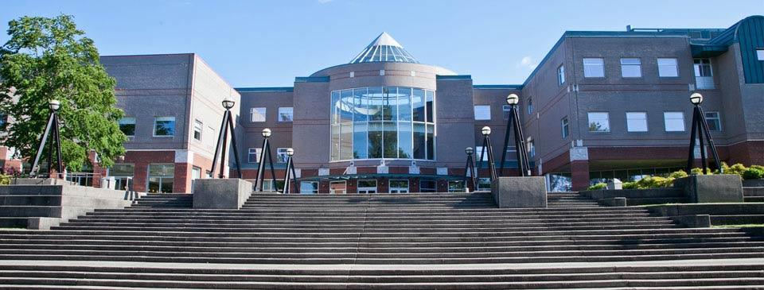
KPU Land Acknowledgment
We are presenting in a region that overlaps with the unceded traditional and ancestral First Nations territories of the Musqueam, Katzie, Semiahmoo, Tsawwassen, Qayqayt and Kwikwetlem, and with the lands of the Kwantlen First Nation.
​

Slide 4
Today’s Session
What is Universal Design For Learning Fellows Program at UBC?
Why is it important?
How we are developing and delivering the program?

Slide 5
What?
UDL Fellows Program
Notes:
UBC is striving to become more inclusive and accessible

Slide 6
UDL Fellows program at UBC
Originated from two collaborative initiatives’ recommendations:
Provincial Level: British Columbia Digital Learning Strategy
Institutional Level: University of British Columbia’s Beyond Covid Report
Supported and funded by the Provost and Vice-President Academic office to build capacity and awareness across campus.
Nominated teams: 16 teams across 11 Faculties + Vantage College​
21 courses identified with a diversity of learning contexts
Projects identified by teams have the potential to impact approximately 5500 UBC students over the next year Winter Term1/Winter Term 2
Notes:
we’ve initiated the Implementation Steering Committee to work under the guidance of the DLAC to launch initiatives over the coming three years in response to the recommendations from the DLAC
Recommendation from Beyond Covid Teaching and Learning
BC Digital Learning Strategy and Provincial Requirement for Accessibility
Provincial Level: British Columbia Digital Learning Strategy Reduce barriers for learners in alignment with emerging provincial standards across post-secondary sector
Institutional Level: University of British Columbia’s Beyond Covid Report: Supporting and Enhancing Learning During and After the Pandemic Era Intentional promotion of UDL resources​
Innovate course designs by incorporating UDL approaches​
Create a cohort of faculty and staff members from across disciplines as UDL experts and practitioners
21 courses identified with a diversity of learning contexts - large and small classes, single and multi-section, graduate/undergraduate, lectures, seminars, field components and labs​
Beyond Covid and BC Digital Learning Strategy Report
Up to 25% of UBC students report having a disability​
48% mental health issues
Disabled students report the lowest sense of belonging
Accommodate 4500 students in all academic programs, with all types of disabilities, in all aspects of their student experience​
Supervise 25,000 accommodated exams/year​
Produce 62,000 pages of alternate format text​
Hire 1000 notetakers or other classroom assistants​
Planned and developed through a collaborative approach.

Slide 7
UDL Fellows Learning Activities

Slide 8
UDL Fellows Program Goals
Identify and address systemic barriers to equitable learning opportunities, to create and sustain equitable and inclusive campuses (supporting UBC Strategic Plan Strategy 4: Inclusive Excellence and enhancing the accessibility of physical and virtual spaces for students, staff, and faculty)​
Improve access and inclusion in on-campus, online and hybrid teaching and learning environments with a focus on barriers for students with disabilities or other accommodations​
Develop a network of practitioners with expertise in applying UDL approaches in the design and delivery of courses across a range of disciplines and who will promote awareness of UDL amongst faculty and staff across UBC​
Develop a range of strategies and resources to help increase support for accessibility in UBC courses and on its campuses
Notes:
Recommendation from Beyond Covid Teaching and Learning
BC Digital Learning Strategy and Provincial Requirement for Accessibility

Slide 9
Why?
UDL Fellows Program
Notes:
AC, Why this program is important? Why accessibility is important?

Slide 10
Accessibility versus Accommodations
Accommodations often address accessibility concerns, but accommodations are student-specific, while accessibility is a broader design and content philosophy
Users who can benefit from accessible design don’t necessarily have accommodations (or identify as “needing” accommodations)
Accommodations can be difficult for students to access; designing for accessibility helps us get around those limits of access, time, and cost
The UBC Centre for Accessibility ensures registered students with documented disabilities receive the accommodations to which they are entitled, but both registered and non-registered learners benefit from accessible course materials and design – at UBC and beyond. Instructors and the community benefit, too!
Notes:
AC? To show data about students needs, registered with CFA and why UDL?

Slide 11
Accessibility is for Everyone
Students who already use adaptive technologies and strategies
Students who don’t necessarily identify as “disabled”
Instructors and TAs
Accessible content is easier to update for systemic changes: LMS and content platform changes, new technologies, updates to departmental, institutional, provincial and federal requirements
By encouraging our UDL Fellows to be open, think deeply, get curious about students’ needs, and embrace accessible design, we help them support their current students, find broader audiences for their work, serve the global learning community, and “future-proof” their course content. We also help our Fellows bring these benefits to their colleagues and home departments.

Slide 12
How?
UDL Fellows Program
Notes:
Natasha? How we are working on the development and delivery of the program in a collaborative way.. To achieve our goals and remove barriers to become more inclusive

Slide 13
Collaboration in Development and Delivery
Partnerships
Centre for Teaching and Learning Technology
Centre for Accessibility
UBC Faculties

Slide 14
Program Components and Activities
Working groups
UDL Hub
UDL Workshops
UDL Canvas shell: announcements,
tasks, resources and dialogue
UDL Studio
Planning meeting
Check-in with whole UDL program team
Independent task focus
Notes:
Natasha?

Slide 15
Support Structure for the Program
Program Planning team
UDL Consultants
Canvas Course Facilitators
Program Level Questions and Feedback
Notes:
Natasha

Slide 16
Resources
British Columbia Digital Learning Strategy https://www2.gov.bc.ca/gov/content/education-training/post-secondary-education/institution-resources-administration/digital-learning-strategy
UBC’s Beyond Covid Report https://academic.ubc.ca/vpa-initiatives/teaching-learning/beyond-covid-report
UBC UDL Fellows Program https://tlef.ubc.ca/application/special-call/universal-design-for-learning-fellows-program/
Notes:
Recommendation from Beyond Covid Teaching and Learning
BC Digital Learning Strategy and Provincial Requirement for Accessibility

Slide 17
Questions

Slide 18
Thank You!
Afsaneh.sharif@ubc.ca
Natasha.Boskic@ubc.ca
AC.Deger@ubc.ca

