Slide 1
ETUG 30th Anniversary
Amanda Coolidge
Executive Director, BCcampus
May 9, 2024
Notes:
Good morning
Thank you to Reeva Billy.
Sharing my own acknowledgement.
My name is Amanda Coolidge. My ancestors come from England and Ireland and Scotland and were uninvited settlers of the Mi'kmaq, Nipmuck Nations, and the Wabanaki Confederacy, now known as Prince Edward Island and Massachusetts. This morning I would like to acknowledge the (Musqueam), Sḵwx̱wú7mesh Úxwumixw (Squamish), səlilwətaɬ (Tsleil-Waututh), on whose lands we are gathering on and who lands we meet on to not only commemorate and celebrate the past but also to work toward solutions for the future.
I acknowledge that my ancestors were colonizers, settlers, and benefited from the colonial structures in place in the past and in place today. I seek change through my work at BCcampus and my commitment to education, and in particular my commitment to education in alignment with the TRCs and UNDRIP.
Welcome everyone to the 30th anniversary of ETUG and the 2024 spring etug workshop, ]This morning I have your attention for 40 minutes in that time I am going to share with you the work BCcampus has been undertaking toward our new strategic plan, and then talk about the emerging trends in post secondary education.

Slide 2
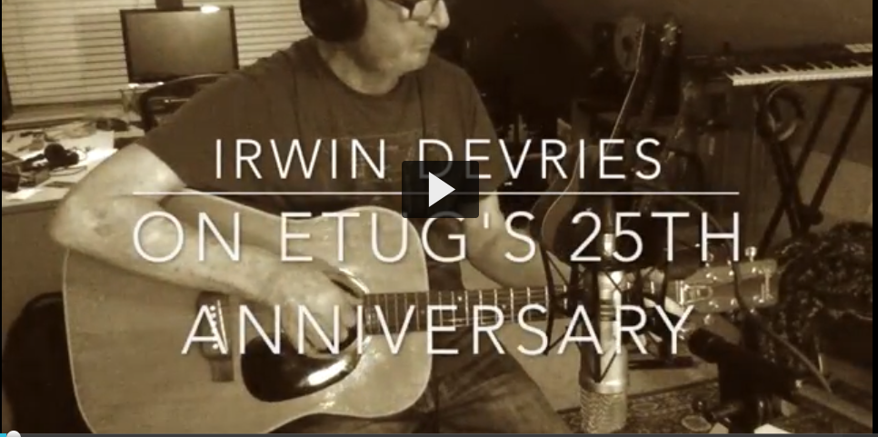
Notes:
However, before we do that I want say that this year our community lost a valuable member, a mentor to many, and a kind hearted soul- Irwin DeVries. who was part of the early developments of open education in British Columbia, an Associate Provost of Open Learning at Thompson Rivers University, and most recently, associate faculty in Education & Technology at Royal Roads University 1. For those who knew Irwin he will always be remembered as an educator, someone who was at the forefront of open education practice and instructional design, and as someone who was one of the early leaders and creators of the Educational Technology Users Group.
As Irwin was one of the early founders of ETUG, I wanted to share some words he recorded for the 25th ETUG Anniversary. In this video, Irwin shares with us the beginnings of ETUG, the origin story if you will. I hope you enjoy hearing his voice again as much as I do.
https://media.bccampus.ca/media/Emeritus+Irwin+DeVries+on+ETUG+25th+Anniversary/0_4lwvi30c
Irwin ended with his hopes for the future and I will echo them- let’s continue to welcome new educational technologists, instructional designers, instructors and students to ETUG. Lets continue to be a space where young professionals feel welcomed and included. And let’s continue to discuss technologies with both enthusiasm and with a critical lense.

Slide 3
BCcampus Strategic Plan
2024-2027
Amanda Coolidge
Executive Director, BCcampus
acoolidge@bccampus.ca

Slide 4
Strategic Planned informed by…
Internal SWOT
Survey
External Survey
125
Emerging Trends
Research and environmental scan on emerging trends in PSI
Educators, Administrators& Teaching & Learning Support Staff
85% from BC PSIs
In person interviews

Slide 5
Critical Challenges
Funding
EDI & Accessibility
Move to hybrid/online teaching
Artificial Intelligence
In your opinion, what are the most critical challenges currently facing B.C. post-secondary teaching and learning?

Slide 6
Which topic areas are most relevant to your work?
Assessment
Online/hybrid teaching
Educational Technology
Open Educational Resources
Open Education Pedagogy
Artificial Intelligence
92%
89%
87%
85%
82%
75%

Slide 7
Comments re: topics of relevance
Indigenization of curriculum, processes
Facilitating collaboration amongst post-secondary institutions
Digital Literacy and AI
Instructional skills, teaching engagement strategies, experiential learning
Research-based teaching and learning

Slide 8
Which of the following services are of value to you and your institution?
Open Collection
Digital Literacy Collection
Pressbooks
Grants for OER
Hosting conferences
Hosting PD webinars
96%
96%
95%
92%
92%
90%

Slide 9
Comments re: services
Educational Developer Community of Practice
Shared education resources, curriculum, and technologies
Collaboration with First Nation-mandated institutions
Climate change education
Support for smaller institutions

Slide 10
What else should we consider in developing our strategic plan?
Collaboration with indigenous communities and indigenous knowledge
OER Discoverability
Stay on top of emerging trends, research in the areas of AI, H5P, etc.
Addressing DRIPA in all BCcampus work
Student participation beyond consulting
Engagement strategies across diversity of PSI

Slide 11
2024-2027 BCcampus Themes
Building relationships and communities
Advancing teaching and learning practices
Supporting organizational excellence
Notes:
Share the printed document- which highights some of our objectives under each theme

Slide 12
Strategic Plan Overview
Theme
Areas of focus
Objective
High level goals
Strategy
Approach to achieve the goal
Activities
Responds to HOW over 3 years

Slide 14
Looking to the Horizon: Emerging Trends in Post-Secondary Education
Notes:
In advance of a strategic planning retreat at the beginning of the year, I researched emerging trends shaping the future of post-secondary education in B.C. and in the country overall to provide context and frame our thinking.

Slide 15
The Emerging Trend of 1994
Notes:
https://youtu.be/XpZ5STahhPE?feature=shared

Slide 16
Trends in Post Secondary Education
Assessment
Climate Crisis
Credentialing Alternatives
Student Mental Health and Well-being
Artificial Intelligence
The resulting environmental scan reveals a focus not only on educational structures and practices but also on wider issues of the climate crisis and student wellness.

Slide 17
AI: Artificial Intelligence
It’s here.
It’s staying.
“Education needs to demand a different type of AI”
- Jutta Treviranus (IDRC)
Not being designed with pedagogy or inclusion in mind.
Notes:
I don’t think I can talk about emerging trends in Post Secondary Institutions without discussing AI. It’s here, it’s staying, and
The trend isn’t so much that AI exists. We know that. The emerging trend is HOW we use AI and why we need to be looking at AI with a critical lense.
The AI being used in our institutions, mostly CHATGPT was not designed with pedagogy or inclusion in mind. It is based on a data set from the past, and in fact an exclusive set of data from the past.
we need to be a part of the design of the AI.
Jutta Treviranus of the Inclusive Design Research Centre based out of OCADU says “education needs to demand a different type of AI she goes on to say “Is what we have been doing in the past the direction we want to go in?”
The accessible BC act became effective in 2022. I bring this to your attention because as such, post secondary institutions needed to bring their community together to draft an accessibility plan for their institution. As we look into procuring future educational technologies, those that may be AI related and those that may be AI detection related (a whole different talk)- we can utilize the accessibility act to ask the questions in the procurement process. Is the tool inclusive? Is the tool equitable? Is the tool bias? How does the tool address diversity? We can start getting involved in the committees to then enact policy in support of our students vs. in harm of our students.

Slide 18
A.I.
Authentic Intelligence
EDUCATIONAL TECHNOLOGY
Notes:
Lacey Robinson, Author of ”Justice Seekers” and the CEO and President of UnboundEd says forget about artificial intelligence and focus on authentic intelligence. As educational technologists I don’t think we can forget about the tool per say, BUT I do think we need to start remembering that the use of technology in our institutions is for education purposes. EDUCATIONAL TECHNOLOGY. Education first… and yet we get so consumed by the tool- what is it going to do, how will it take over our school systems, how will it take over our jobs.
If we want our students to be using AI and learning about AI, we, as educational technologist and Instructors need to be well versed in what AI is- what are the core competencies we are actually wanting our students to graduate with? Evaluation skills, critical thinking skills, analytical skills and the ability to create.

Slide 19
Assessment
Assessment redesign is the antidote to the fear that students are cheating.
FLO Lab: Maximizing Student Learning with Assessment -As, -For, and -Of Learning
May 22 @ 9:00 am – 12:00 pm
Notes:
Students do not come to post secondary to cheat, they come to learn. . Here’s the thing- students are using AI. In fact, most of us are using AI in some form or another. And why are students using AI? For many reasons- feedback mechanisms, simplification of complex topics, support in breaking down essay topics.
But you want to know what gets me jazzed about AI tools? THIS. Assessment redesign. I have been talking about assessment redesign for the last 23 years as an instructional designer. It’s what I needed as a student- a different approach to assessing my competencies. What I want to see more of is the celebration of good assessment redesign. If the main concern of AI is student’s cheating (not their privacy or security), then we need to be supporting our instructors in HOW to redesign assessments that engage the student, and evaluate them on authentic intelligence. As AI continues to grow at a faster rate than we can teach it, I want to see great examples of assessment- ones that are redesigned because rather than policing students because of the fear they will use AI to cheat, they instead are re-designed to perhaps even use AI to co create, evaluate, and critically analyze.

Slide 20
Credentialing Alternatives
“Twenty years from now, lines between people’s learning and working lives will be increasingly joined. Learning will not be something you graduate from to transition to a job but will be a lifelong journey of upskilling and micro-credentialing to keep up with exponential advances in technology and changes in the workplace that will build a better economy and society.”
— KPMG, 20 Predictions for the Next 20 Years
Notes:
There is an increased focus on and demand for workforce skills and concern regarding the cost of a college education and student loan debt, digital badges and microcredentials will continue to play a role in higher education and require those focused on teaching and learning to consider how to better integrate these short, career focused learning experiences into existing curriculum.
But the question is how best to design work integrated learning experiences, as well as badging and microcredentials to meet the needs of the students?
This toolkit aims to support micro-credential practitioners – members of the B.C. post-secondary community who are developing and offering stand-alone, short duration learning experiences that are competency-based, align with industry, employer, community and/or Indigenous community needs and can be assessed and recognized for employment or learning purposes. The toolkit compiles knowledge, resources, templates, and experiences from the sector to support the community. It also proposes lists of questions that practitioners can explore in laying down a solid foundation in their context. Each self-contained chapter covers one aspect of offering micro-credentials, from sustainable budgeting strategy, to partnerships in and out of the institution, to governance and quality assurance, to forging educational pathways to connect micro-credentials to further educational opportunities in the system.

Slide 21
Climate Crisis
“Everyone is going to need to understand [climate change] the same way you’d assume everyone in business needs to have some fluency in social media today, or that everyone would be able to use a computer 20 years ago.”
— Andrew S. Winston, The Big Pivot: Radically Practical Strategies for a Hotter, Scarcer, and More Open World
Highest number of related programs on climate change and sustainability in B.C.
BCIT
Coast Mountain College
North Island College
Vancouver Island University
Notes:
The climate crisis presents an imminent and escalating threat to the planet, demanding urgent action.. In response, B.C. institutions, like others around the world, are grappling with ways to incorporate and give prominence to these serious issues.
Some post-secondary institutions are considering making it a requirement for students to take an introductory course on climate change. Others are increasing their course offerings examining the relationship between social and natural causes of climate change. The B.C. institutions with the highest number of related programs on climate change and sustainability include the British Columbia Institute of Technology, Vancouver Island University, Coast Mountain College, and North Island College.

Slide 22
Climate Adaptation @ Royal Roads University
Notes:
Courses and microcrednetial offerings such as Climate Adaptation Fundamentals and the Master of Arts in Climate Action Leadership at Royal Roads University are addressing the skills gaps when it comes to addressing the climate crisis.

Slide 23
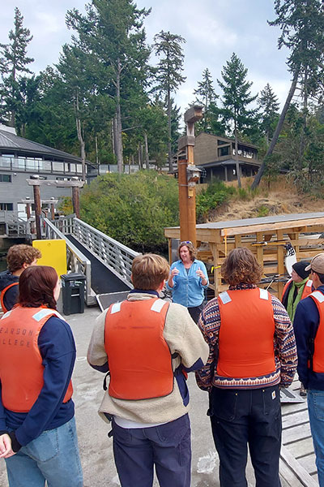
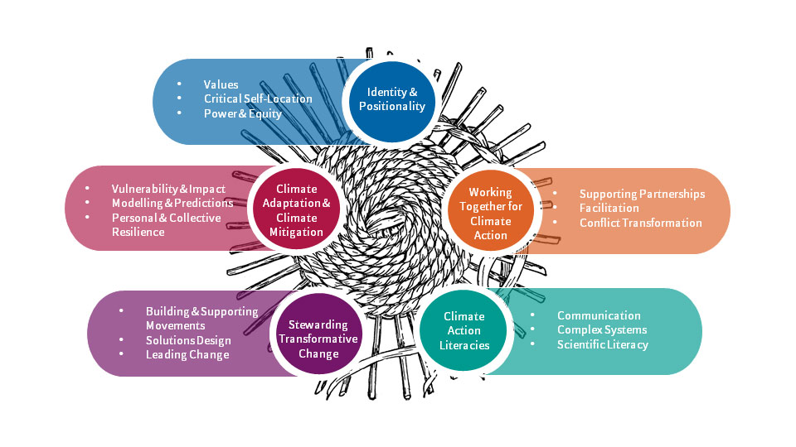
Pearson College UWC: Climate Action Leadership Diploma
Notes:
Pearson College UWC launched an exciting and innovative new IB program curriculum option in the 2022-23 academic year ​ for students with a passion for tackling the most pressing issue facing humanity – climate change. The new Climate Action Leadership Diploma is an IB Career-related Program (IBCP) and is the first of its kind, a two-year diploma for 16-19-year-olds who wish to specialize in climate leadership.
The Climate Action Leadership Diploma is delivered over 600 hours of instruction spread over 2 years and consists of:
1. University-level Courses, in partnership with Camosun College and Royal Roads University
2. Bespoke UWC Programming – Leading Climate Action Developed and delivered in-house, with invited external speakers, guest lecturers, and direct place-based experiences, this course runs alongside and complements the knowledge, skills, values, and attributes students are learning in the university level and CP Core courses.
3. Micro-credentials The CALD program provides unique opportunities for students to develop specific skills in facilitation, conflict transformation, climate modelling, and understanding the legal rights of individuals participating in direct action. These certifications are achieved through either self-directed study or whole-cohort workshops led by external organizations.

Slide 24
Student Mental Health and Well Being
https://bccampus.ca/projects/archives/wellness/mental-health-and-wellness/
Notes:
People aged 15–24 are more likely to experience mental health issues than any other age group and comprise a significant portion of the post-secondary student body. At the pan-Canadian level, in 2020 the Mental Health Commission of Canada released the National Standard of Canada for Mental Health and Well-Being for Post-Secondary Students. Institutional initiatives such as on-campus counselling, peer support groups, academic preparation sessions, and other services are meant to ensure mentally healthy and fulfilling environments for all students.
This is why a pedagogy of care or an institution of student care is so important. And that is not just the role of the faculty member. This is a role for every touch point a student encounters from registration- by having ability to register under a preffered name with preferred pronouns, to accessing their courses – where it be the use of OER in a course to support affordability, in the choices adminsitratiors make on educational technology- what is the impact to the student, what data is being collected, how is this the technology ethical and just- or in the design of a course where you can suggest to an instructor where is there space for students to provide alternative forms of assessment to demonstrate understanding.

Slide 25
Trends in Post Secondary Education
Assessment
Climate Crisis
Credentialing Alternatives
Student Mental Health and Well-being
Artificial Intelligence
Notes:
While there are many more trends that can be discussed, I purposely chose the few I spoke about because I also wanted to share the trends that I want to see put at the forefront of our institutions.
With AI- I want us to be reviewing these tools with a critical lens, I want institutions to remember it’s education first always, to be procuring educational technologies that are in favor of the student vs. in harm of the student, and ultimately to be trending toward the support of authentic intelligence as we utilize artificial intelligence tools in the classroom.
Assessment- redesigning assessment is critical to changing the narrative that AI is only a tool for cheating. And as I mentioned, I want to see more celebration of instructors who are re-designing assessment - the more we celebrate this and share ways of redesign, I believe we can move the trend in an upward momentum to thoughtful and purposeful assessment redesign.
Credentialing Alternatives- what I like about the trend toward credentialing alternatives is the value placed on life long learning
Climate Crisis- Dr Vanessa Andreotti, Professor and Dean of Faculty of Education at UVIC says “the BUCK stops here” when it comes to climate education. I don’t necessarily want to be putting climate crisis up here as a trend, because trends come and go- and to be honest the climate crisis isn’t going anywhere. But like I said, I;m sharing these topics as a way to say these topics or trends are VITAL for future generations- not just of learners, but of our humanity/
Student Mental Health and Well being: Student mental health isn’t a one-off project.. It’s an ongoing commitment that extends beyond implementation. So much of what are emerging as trends in PSI directly affect student mental health, from the educational technologies we procure that may cause harm to students, to the way in which we assess, to offering students alternative ways of learning, and to actually addressing the challenges that face our humanity by offering programs to help studemts be a part of the solution.

Slide 26
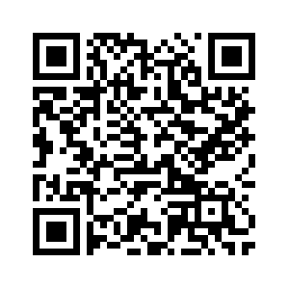
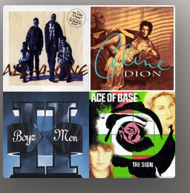
Notes:
As a thank you and a bit of nostalgia I ask ChatGPT to put together the top 10 songs from 1994- you can access the playlist on spotfiy but scanning the QR code above.
Thank you!

