Slide 1
ETUG 2024
Sally Goldberg Powell
Instructional Technologist, Digital Learning
she/her
Assessing Assessments, PartyRock Style
No-code GenAI-powered apps

Slide 2
GenAI and Assessments
The first point of concern to surface after the release of ChatGPT
GenAI Teaching Partners program: working with instructors to mitigate, clarify and in some cases, integrate the use of GenAI in assessments.
Looking for ways to utilise a GenAI tools in our work and demonstrate its capabilities to instructors
Created with Titan Image Generator G1 through PartyRock using the prompt “a robot taking a written test”

Slide 3
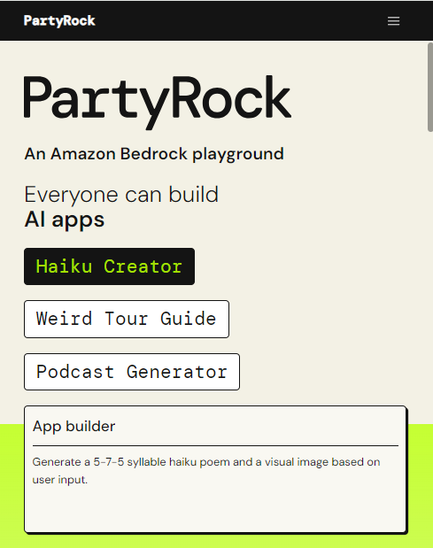
Why PartyRock?
partyrock.aws
Free to use, share, and remix
(unlike GPTs)
AI-generated app
(but fully customizable and infinitely editable)
Clear privacy statement
(opt-out option!)
Uses Anthropic’s Claude
(not available in Canada otherwise, at the time )

Slide 4
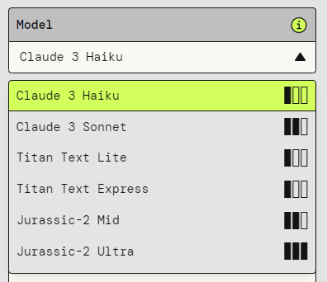
Why PartyRock?
Anthropic: Championing Transparency and Control
“Unlike OpenAI’s focus on capability alone, Anthropic prioritizes building trust and ensuring responsible development through proactive safety measures and a commitment to transparency.”
The Ethical AGI Arms Race: Anthropic vs. OpenAI in the Pursuit of Safe Artificial Intelligence | by Sajjad Fakharian | Medium
Models available in PartyRock
as of May 8, 2024

Slide 5
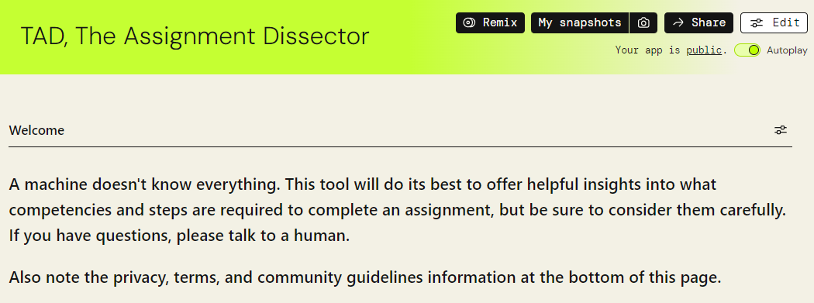
Demo: TAD, The Assignment Dissector 🤖

Slide 6
Demo: The AI-Resistant Assignment Companion (AIRAC) 🤖

Slide 7
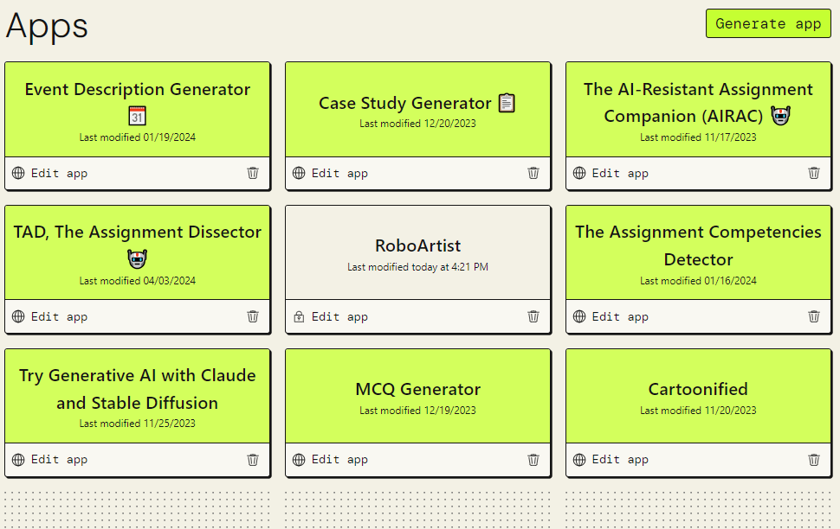
My Apps (so far)

Slide 8
Reach out! I’d love to chat.
sgpowell@torontomu.ca
linkedin.com/in/sgpowell/

