Slide 1
Integrating Digital Literacy in Your Classroom
Skills, Stories, and Strategies
Gwen Nguyen
BCcampus
gnguyen@bccampus.ca
May 9-10, 2024
Notes:
Hello everyone, my name is Gwen and I am an advisor with the Teaching and Learning Team at BCcampus. My recent research interests are primarily focused on digital pedagogies in higher education and arts-based teaching and learning practices. At BCcampus, in the past two years I’ve had an opportunity to work with my teammates and contributing to the Digital Literacy Open Educational Resource Collection Project as a pathway designer. My work has involved in the development of the content for the Superpower Quiz, and some other resources featured on the BC Digital Literacy Hub. Before joining BCcampus, I worked as a sessional instructor in the Curriculum and Instruction department at the University of Victoria, teaching pre-service teachers. During the pandemic, I joined the division of teaching and learning as a learning experience designer. Whether working directly with students or supporting faculty and staff, I believe in continuous learning and development of digital literacy skills, both as facilitators and for empowering learners in their respective fields.
Today I’m so excited to share my thoughts on “Integrating Digital Literacy in Your classroom: skills, stories and strategies.

Slide 2
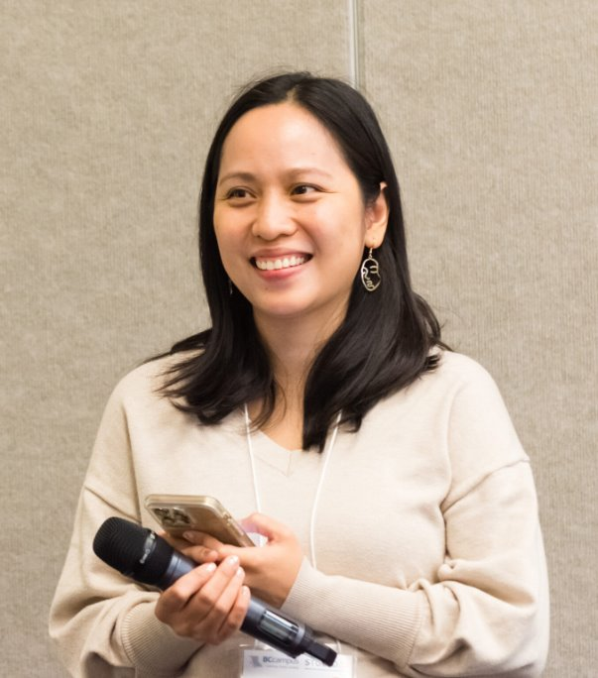
Notes:
Having worked and grown in higher education since 2000, I've seen digital literacy evolve tremendously. Gone are the days when basic computer skills, filling spreadsheets, and attaching documents to emails were considered sufficient. Technology has transformed so quickly, and so have the needs of our students, instructors, and the broader community.
BTW, I want to share something fun. I have two pictures here: one is a photo taken when I was presenting at Studio23 conference, and the other was generated by Dall-E. I was amazed by how pretty the AI-generated version turned out. I showed it to my little girls, and they said, "Mami, you look like a princess with a smartphone and microphone! I still like you more though."

Slide 3
In this session, we will
Skills
Stories
Strategies
discuss the core digital educator competencies aligned with the BC Digital Literacy Framework
share successful stories and challenges faced in integrating digital literacy teaching
explore practical activities from Digital Literacy Hub’s mini-lesson plan portal
Illustration of a digital competent educator in higher education (generated by DALL-E)
Notes:
It's challenging to stay on top of technological advancements, and sometimes it can feel overwhelming. However, this is a powerful opportunity for us to come together, think, share, and navigate these changes collectively through honest open and sustained conversations.
And that is the whole reason for this session. As its title, in this session we'll discuss core digital educator competencies aligned with the BC Digital Literacy Framework. I'll also open the floor for us to share success stories and challenges in integrating digital literacy teaching to inspire and empower each other on this journey. After sharing these stories, we'll explore practical activities from the Digital Literacy Hub's mini-lesson plan portal.

Slide 4
Notes:
To kick things off, let’s participate in a mentimeter activity with 2 first questions to consider digital educator competencies
What skills do you believe are essential for educators to effectively navigate the digital landscape in today’s classrooms?
What qualities differentiate a proficient digital educator from a traditional educator?
Thank you for sharing your thoughts on digital educator competencies.

Slide 5
What skills do you believe are essential for educators to effectively navigate the digital landscape in today’s classrooms?

Slide 6
What qualities differentiate a proficient digital educator from a traditional educator?

Slide 7
Digital Teacher Competencies
Digital teacher competencies are “the set of skills, attitudes, and knowledge required by educators to support student learning in a technologically rich world, design, and transform classroom practices and enrich their professional development.” (Esteve-Mon et al., 2020, p.1)
Notes:
The origin of the teaching and learning by competencies approach is actually the result of social changes that we have been living in the last decades. More recently, globalization has been rapidly expanding, and we've seen the urgent adaptation of face-to-face teaching to emergency remote teaching due to the COVID-19 health crisis. This adaptation clearly illustrates the digital evolution in education.
Digital competence has gained significant prominence in the educational context, as technology is now an everyday necessity. According to Cabero et al. (2020), digital competence is one of the key competencies that educators must master to thrive in future teaching.
Definitions of "digital teacher competence" vary, but there are common threads. They emphasize the need for educators to have both didactic and technological knowledge to effectively utilize digital technologies in their professional practice. Core aspects of this competence include technological, informational, multimedia, communicative, collaborative, and ethical dimensions.
Castañeda et al. argue that teacher digital competence must be holistic, situated, systemic, trainable, and constantly developing. It should integrate skills, attitudes, and knowledge necessary for educators to support their students as active participants in a digital world.
Digital teacher competencies are “the set of skills, attitudes, and knowledge required by educators to support student learning in a technologically rich world, design, and transform classroom practices and enrich their professional development.” (Esteve-Mon et al., 2020, p.1)

Slide 8
Four common areas:
Basic digital skills
The pedagogical application of digital technologies
The use of technology for continuous professional development
The ability to further digital competencies for university students
(Esteve-Mon et al., 2020, p. 401)
Notes:
There might be different definitions in the literature when talking about digital teaching competence or digital teaching literacy. However, There are 4 common areas of digital teacher competencies that most definitions suggest:
Basic digital skills (generic digital competence)
The pedagogical application of digital technologies (competence to integrate technologies into teaching practice)
The use of technology for continuous professional development
The ability to further digital competencies for university students (critical use of technology and teaching students who are using technology and professional digital competence)

Slide 9
BC Holistic Digital Literacy
Ethical and Legal Considerations
Digital Scholarship
Community-based Learning
Digital Wellbeing
Information Literacy
Technology Supports
Creation and Curation
Communication and Collaboration
8 competencies
Notes:
Gwen
The B.C. Post-Secondary Digital Literacy Framework
https://www2.gov.bc.ca/assets/download/CE7169BE53BA4728A311A0F0B41E3059
These are aspirational skills, knowledge, and abilities necessary to participate in digital society, especially among members of PSIs in BC.
The Digital Literacy Framework presents this comprehensive view by including 8 competencies: ethical and legal considerations; technology supports; communication and collaboration; creation and curation; information literacy; digital scholarship; community-based learning; and digital wellbeing.
what we see here is that digital literacy reflects not only t technical skills, but also cognitive skills, attitudes, and ethical and legal considerations.This holistic approach to digital literacy is key to navigating our educational landscape.
Now, Instead of delving into every detail, We'll explore the language and terms used in the framework, breaking down these competencies to foster an environment where we can share and discuss these concepts together. I want to acknowledge Taruna Goel, who introduced this approach of deconstructing the competencies when she developed this FLO microcourse in early March this year.
Building digital teacher competencies should be a dynamic journey because technology continues to evolve rapidly, requiring educators to adapt and stay current. By attending professional development opportunities and engaging in active conversations, teachers can refine their skills and remain informed about emerging trends. Modeling this active, adaptive, and curious approach to learning not only benefits educators but also sets an example for students, demonstrating the importance of lifelong learning and encouraging them to approach new challenges with a growth mindset. This adaptability ensures educators are prepared to integrate technology effectively into their practice, ultimately enhancing the learning experience for their students.

Slide 10
Ethical and Legal Considerations
Follow digital accessibility standards and guidelines when develop content
develop and model awareness around Indigenous protocols for using Indigenous knowledge, information, and intellectual property
Support students in understanding and following academic integrity guidelines

Slide 11
Technology Support
select technologies mindfully for different activities in courses (considering ethics, accessibility, technical support resources at the institution, affordability and learners’ cognitive loads)
Ensure students have technology skills that are specific to the work or studies
Support students with learning strategies for learning how to use new technologies

Slide 12
Information Literacy
Provide students with information literacy lessons to identify, differentiate, use different types of online information, and develop understanding of how online information is produced, prioritized, and presented
use digital information and tools to expand knowledge and provide multiple perspectives in coursework

Slide 13
Digital Scholarship
Collaborate with peers to develop digital learning opportunities, maintaining consistency across curriculums
Teach learners citation methods, how to use digital resources for their own learning, how to filters to refine research results, how to complete online components of courses

Slide 14
Communication and Collaboration
design and facilitate collaborative learning experiences in digital spaces
Understanding that cultural values may lead to different ways of participating in online spaces
Teach students tools and strategies for collaborating online, how to respond appropriately when online conflict, abuse arises, and how to work with others flexibly (online, in-person, synchronous, asynchronous)

Slide 15
Creation and Curation
develop learning resources that uphold accessibility protocols
Using different technologies to enhance digital learning opportunities LMS, Visuals, Idea Clouds, Whiteboards, Polls)
Teach students tools and strategies to creatively express themselves.

Slide 16
Digital Wellbeing
Being intentional when sharing and consuming digital content
Take breaks from digital spaces
Develop strategies for managing technology especially it impacts physical, mental, and emotional health
Teach students that search engines, websites, platforms, the Internet of Things contribute to their digital footprints

Slide 17
Community-based Learning
Provide opportunities for learners to participate in community-based learning (using co-creation model, placing community expertise at heart)
Developing a safe digital space for community/learner collaborations that are respectful of Indigenous people, protocols, and priorities (distinction-based approach, etc.)
Teach students that access and expertise with digital technologies vary across and within communities ​

Slide 18
Building digital teacher competencies
is a dynamic learning journey.

Slide 19
My story
Course: Principles of Teaching Learners of English as an additional Language
Digital tool: Wordpress
Context: Pre-service teachers visited local schools to engage with English language learners in the classroom. Interview and share reflection as well as develop their lessons
→ Promote critical thinking, accessibility, students’ engagement, collaboration, communication and creation
Notes:
Context: Pre-service teachers visited local schools to observe lessons and engage with English language learners in the classroom. They conducted interviews, wrote reflections, and developed a syllabus featuring five mini-lessons tailored to support these students based on their needs as identified in the interviews. The pre-service teachers then shared their reflections and syllabi with classroom teachers, seeking feedback where available.
Implementation:
Introduction to WordPress: At the beginning of the course, students were guided through using WordPress and directed to relevant tutorials. Assistance was made readily available for questions and support.
Critical Thinking and Accessibility: WordPress promoted critical thinking and accessibility through different forms of blogging, such as audio, video, written, and visual formats.
Student Engagement and Collaboration: The platform enhanced student engagement, collaboration, communication, and creativity by facilitating the sharing of ideas and materials.
Open and ongoing Feedback and follow-up with Classroom Teachers and students: Students learned to work with classroom teachers through the open feedback process, allowing them to receive constructive critiques and refine their teaching practices.
This approach significantly enriched the learning experience by fostering a supportive and innovative environment that encouraged reflection, peer collaboration, and engagement with classroom teachers.

Slide 20
Sharing Stories

Slide 21
What do you see as challenges for educators in integrating digital literacy into their teaching practice?

Slide 22
How can these challenges be addressed?

Slide 23
Considerations
Participate in professional development for educators and staff related to Digital Literacy
Curriculum design should prioritize the integration of digital literacy across disciplines and academic program
Courses and assignments should be designed to foster human elements, such as, critical thinking, creativity, problem-solving, collaboration, communication …
Act as an academic advisor, refer students to comprehensive support services to help students navigate digital learning environments ( technical support, digital literacy workshops, access to online open educational resources, and tutorials)
Notes:
I may not have all the answers, but based on research and literature, these considerations could help address challenges in integrating digital literacy:
Engage in Professional Development: Educators and staff should participate in professional development opportunities related to digital literacy.
Curriculum Design: Ensure curriculum design prioritizes the integration of digital literacy across disciplines and academic programs.
Course Design: Courses and assignments should be structured to foster critical thinking, creativity, problem-solving, collaboration, and communication.
Start with reviewing learning outcomes (brainstorming different ways a learning could meet learning goals and imagine how to support those students to achieve those learning outcomes)
Use Plus One Approach: Ask yourself what is the one thing can I choose to add to my practice today? For instance, if a course already requires students to submit traditional essays, the "Plus One" change could be to allow them submit their essays in a blog format, thereby introducing them to content management systems and online publishing.
Rather than teaching digital literacy and technology skills as separate or isolated topics, you should integrate them across the curriculum and embed them in the content, activities, and assessments of your courses. For example, you can use digital tools and platforms such as Google Docs, Padlet, or Kahoot to facilitate collaborative learning, peer feedback, and formative assessment. You can also use online resources such as videos, podcasts, or blogs to supplement your lectures,
Academic Advising and Support Services: Act as an academic advisor, guiding students to comprehensive support services to help them navigate digital learning environments. This includes providing technical support, digital literacy workshops, access to online open educational resources, and tutorials.

Slide 24
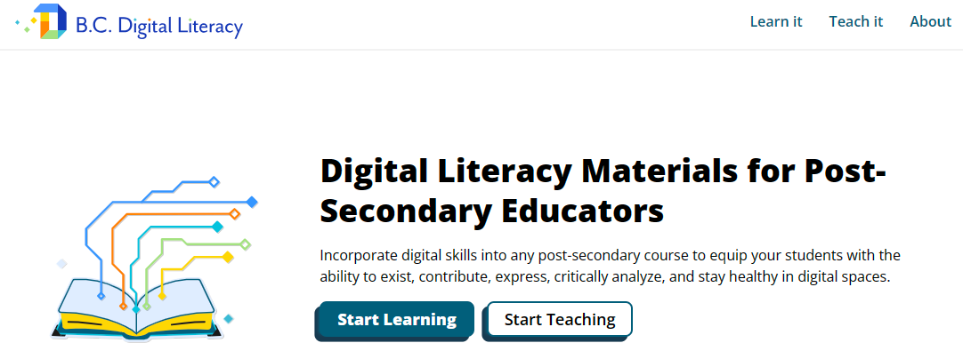
https://digitalliteracy.bccampus.ca/
Notes:
In this final part of our session, I'd like us to explore a collection of mini-lessons from the course pack on the BC Digital Literacy Hub, which I designed and have been peer-reviewed. Let's revisit the reflections we made at the beginning, choose a competency that resonates with you and aligns with your practice, and then explore the relevant mini-lesson.
Afterward, you'll join a group, briefly describe the selected mini-lesson plan available for exploration, and share your reviews and thoughts, guided by some provided questions. You don't need to follow or answer all the questions in order; they're simply there to facilitate our discussion.

Slide 25
Guiding questions
Which lesson did you choose?
How might this lesson fit into your curriculum or teaching practice?
How do the lesson’s concepts or strategies resonate with you?
Did you notice any gaps in the lesson plan?
What new ideas or adaptations could you make to customize the lesson?

Slide 26
Reference
Esteve-Mon, F. M., Llopis-Nebot, M. A., & Adell-Segura, J. (2020). Digital teaching competence of university teachers: A systematic review of the literature. IEEE Revista Iberoamericana de Tecnologías Del Aprendizaje, 15(4), 399–406. https://doi.org/10.1109/RITA.2020.3033225

Slide 27
Thank you!

Slide 28
Notes:
As you all share a passion for teaching and learning with technology, please consider becoming one of our next EdTech Sandbox leaders. This is an excellent opportunity to share your expertise and introduce innovative tools. In this upcoming series, which focuses on both adopting new emerging AI tools and avoiding some tools (including AI) in education, you'll help fellow educators make informed decisions.
Moreover, you'll have the chance to network with other EdTech leaders across the province and receive $750 as compensation for your participation in this initiative. The deadline for submissions is May 31st.

Slide 29
Notes:
BCcampus is hitting the road! Our goal is to connect with educators around the province, exploring the latest trends and building skills in digital literacy, open education, and more. If you're nearby one of our regional stops — Okanagan College, Thompson Rivers University, and Selkirk College — please come by, say hi, and participate in our offerings. For more details, visit BCcampus Roadshow

