Slide 1
Breaking with tradition: The digital teaching case flipbook
Jo Axe, Professor, School of Education and Technology
Rebecca Wilson-Mah, Associate Professor, School of Tourism and Hospitality Management
Ken Jeffery, Associate Director, Centre for Teaching and Educational Technologies
Notes:
RWM
Teaching cases are a popular pedagogy in business and management studies. Typically presented in a traditional print style in black and white, the presentation of teaching cases tend to follow a conventional format. In this session, we will share an example of a recently written teaching case that is presented in a dynamic digital PDF flipbook including embedded images, audio and links. Working with the Centre for Teaching and Educational Technologies at Royal Roads University, the presenters will share their experiences with this project, some examples of traditional case presentation, and the flip book example. While the digital flipbook engages students with colour, imagery, and flippable pages, the audio recording embedded in the flip book improves accessibility for the visually impaired or differently abled. Digital flipbooks offer more accessible learning materials and are a positive advancement for the future presentation of teaching cases.

Slide 2
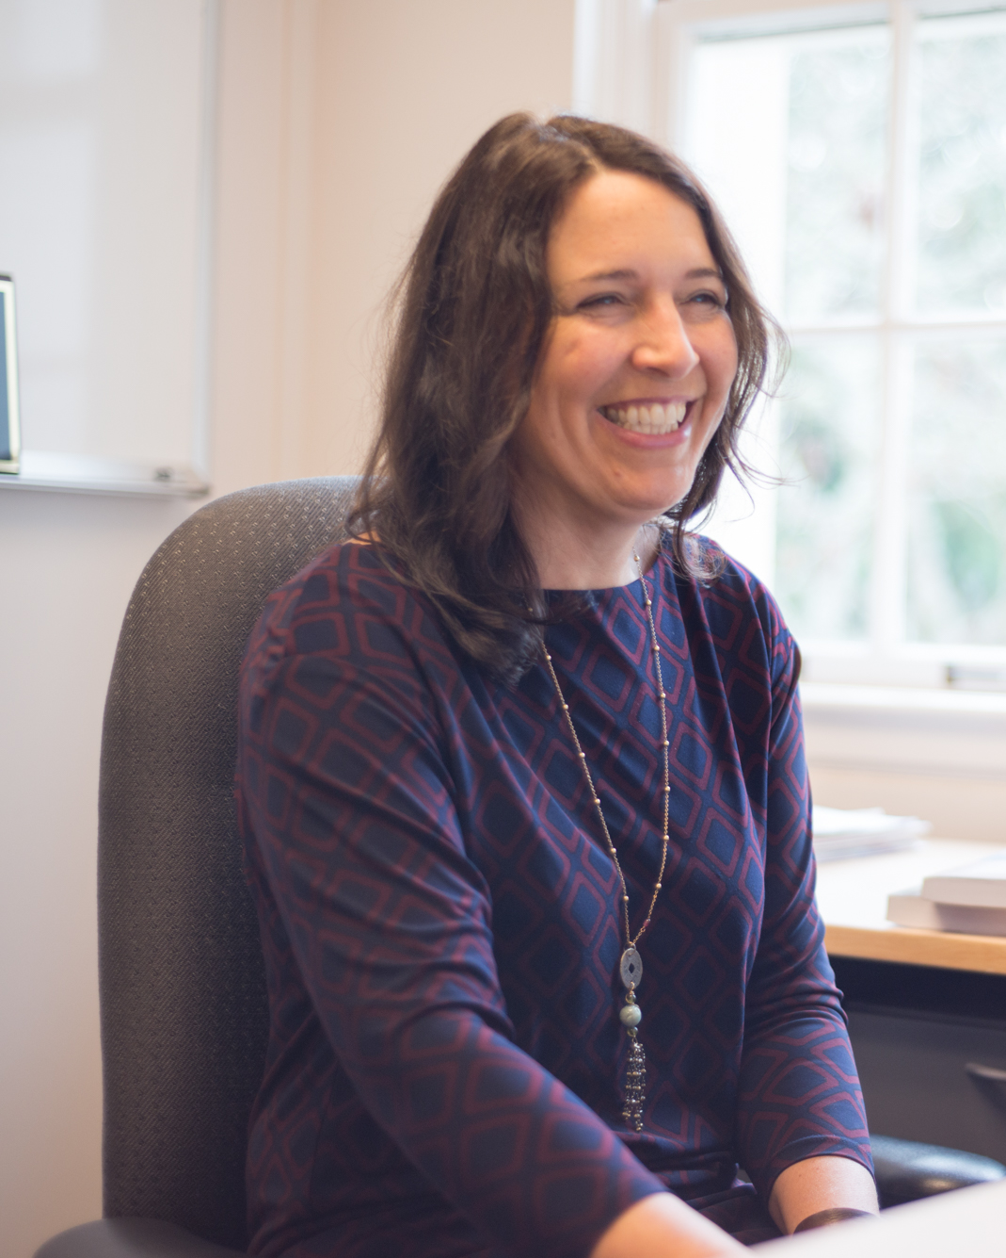
Introductions
Rebecca Wilson-Mah, EdD, CPHR
Associate Professor and Program Head MA Tourism Management
School of Tourism and Hospitality Management
Jo Axe, PhD, CPA, CGA
Professor and Program Head, MA Interdisciplinary Studies
School of Education and Technology and College of Interdisciplinary Studies
Ken Jeffery, MA
Associate Director,
Centre for Teaching and Education Technologies
Notes:
All

Slide 3
Agenda
Traditional teaching cases
The new project – a coaching case
The flip book
Q & A
Notes:
RWM

Slide 4
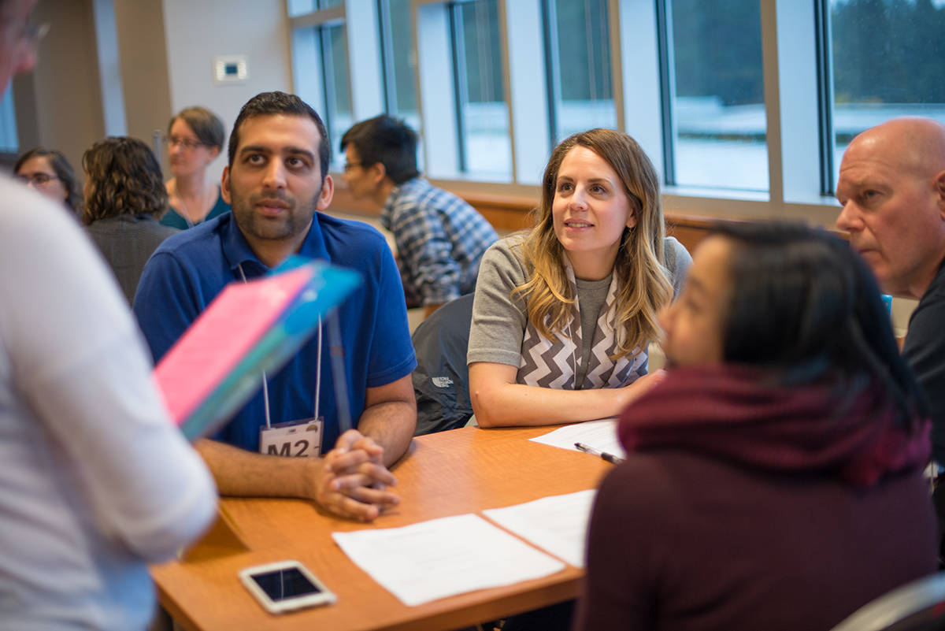
Check in! I’m thrilled to be here because…
Notes:
RWM

Slide 5
Teaching Cases
NARRATIVE
FACTS
DECISION OR ANALYSIS
PAST TENSE
EXHIBITS
Notes:
RWM

Slide 6
Notes:
RWM
Opportunity - Digital Case Flipbook – I’m passing the baton to Jo who will dig deeper into the opportunity we identified for a digital case flipbook

Slide 7
The Opportunity…
Accessibility
Engagement
Distribution
Representation
Notes:
JA
Accessibility
Distribution
Engagement
Representation

Slide 8
The Teaching Case – Foundational Research
Applied Coaching Project Abstract
The question of the need for the coaching profession to understand the impact of race in coaching relationships was examined by integrating primary research from a focus group of white male coaches and a meta-synthesis of peer reviewed literature related to coaching and racism. Critical Race Theory was engaged to raise the question of race, and disciplines such as education, psychology and social work were investigated to augment the small amount to critical literature related to race and coaching. Based in the experience of the focus group participants and the analysis of related literature, ten recommendations are offered to coach educators and professional bodies to enhance the capacity of coaching to meet the challenges of systemic racism.
Duggan, B. (2023). How can white male coaches respond to the call-to-action challenging coaching educators to support anti-racism in coaching? [Unpublished applied coaching project]. Royal Roads University
Notes:
JA – high level focus of the case

Slide 9
The process from research project to teaching case
Student’s applied coaching project
Approximately 40 pages
Traditional thesis structure
Recommendations presented
Extensive literature cited
Academic writing style
The teaching case
Approximately 6 pages
Teaching case structure
Recommendations to be developed
Some resources provided
Storytelling writing style
Notes:
JA

Slide 10
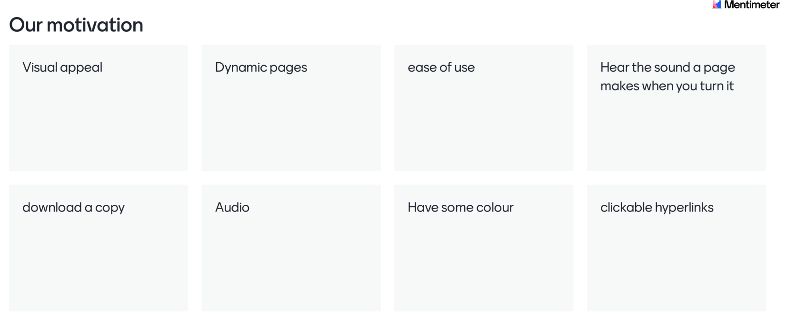
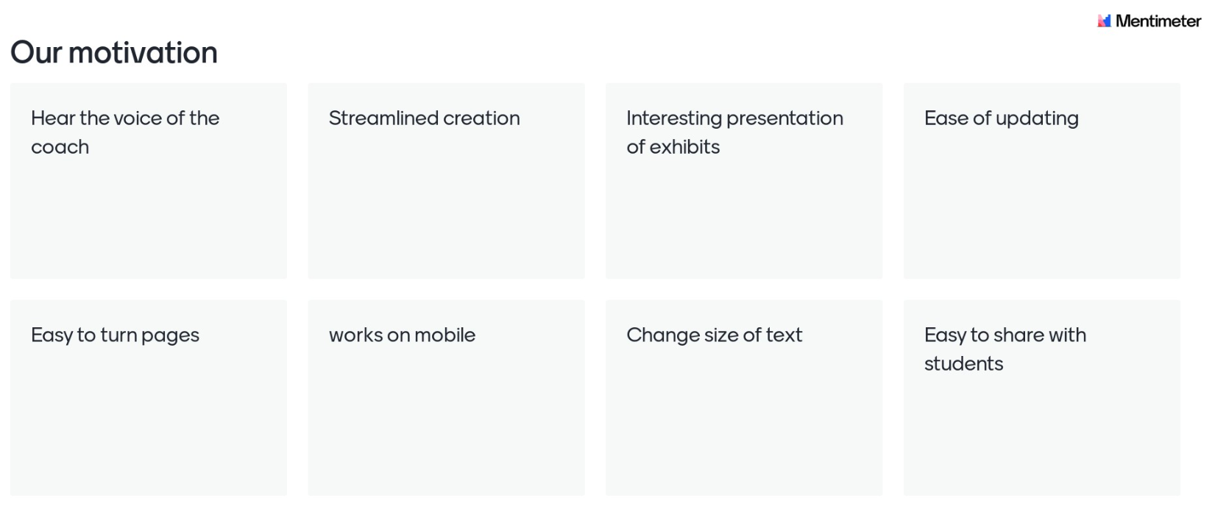
Notes:
JA
Our motivation

Slide 11
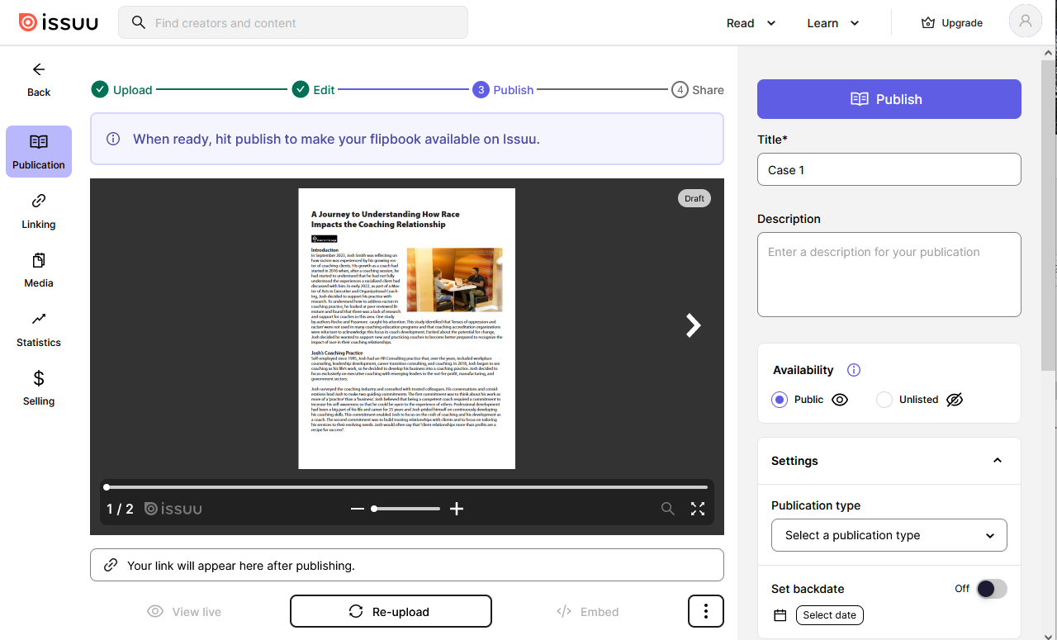
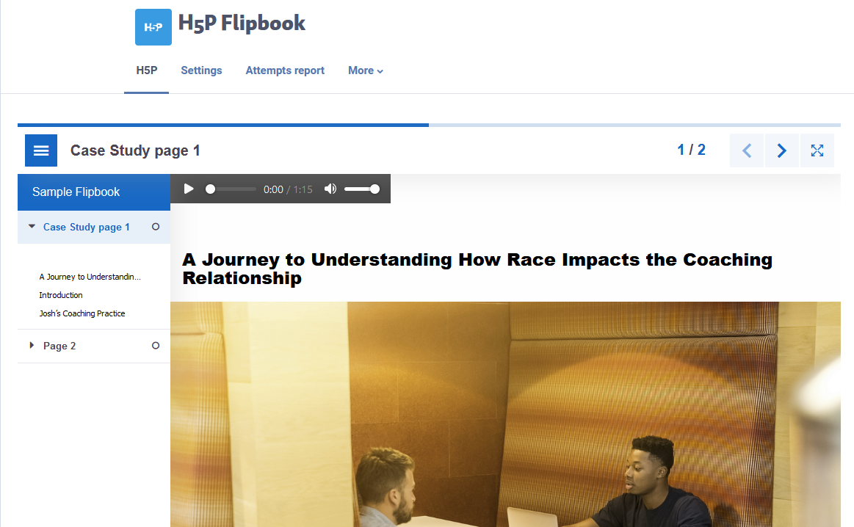
Three options explored
Issuu
H5P
AnyFlip
Notes:
KJ – not sure if this slide is needed or not…

Slide 12
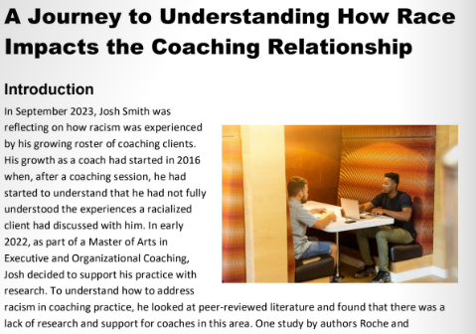
https://anyflip.com/spffr/pvjh/
Digital Teaching Case
Notes:
KJ

Slide 13
Thank you!

